Slide 1
DATA SCIENCE PORTFOLIO PROJECT
Telecom Customer Churn & Retention Analytics
26.54%
churn rate
Data-Driven Insights for Customer Retention
Dataset: IBM Telco Customer Churn
Tools: Excel, SQL, Python, Power BI
Churned: 1,869
Retained: 5,174
STUDENT
COLLEGE
ROLL NUMBER
PRESENTATION DATE
Virender Sahu
Delhi Technological University (DTU)
23/EE/286
20 October 2026
Notes:
Introduce the project, dataset (IBM Telco Customer Churn), tools, and student details. The donut shows the overall split: 1,869 churned vs 5,174 retained customers.

Slide 2
Executive Summary
7,043
1,869
5,174
26.54%
73.46%
Total Customers
Churned Customers
Retained Customers
Churn Rate
Retention Rate
Why churn matters to a telecom business
Roughly one in four customers in this dataset churned (26.54%), which means lost recurring revenue.
Retaining existing customers is generally more cost-effective than acquiring replacements.
Knowing which segments churn most lets teams focus retention effort where it matters.
Notes:
Five headline KPIs. 1,869 churned of 7,043 gives 26.54%; 5,174 retained gives 73.46%. Explain why churn matters commercially.

Slide 3
Project Objectives & Workflow
OBJECTIVES
1
Measure overall customer churn.
2
Identify high-risk customer segments.
3
Analyze contract types, tenure, monthly charges, and services.
4
Develop actionable customer retention recommendations.
WORKFLOW
1
2
3
4
5
6
Data Collection
Data Cleaning
Exploratory Data Analysis
SQL Analysis
Power BI Dashboard
Business Recommendations
Notes:
Four objectives, then the six-step workflow from data collection through to business recommendations.

Slide 4
Dataset & Data Quality
7,043
21
11
Total records
Total columns
Missing TotalCharges values
7,043
0
Identified during validation. These records should not be silently deleted; any handling decision should be documented and the original rows preserved.
Unique customer IDs
Duplicate rows
Dataset
IBM Telco Customer Churn
Notes:
7,043 rows, 21 columns, 7,043 unique IDs, no duplicates. 11 missing TotalCharges values were flagged and kept rather than silently removed.

Slide 5
Churn by Contract Type
Contract | Customers | Churned | Rate
Month-to-month | 3,875 | 1,655 | 42.71%
One year | 1,473 | 166 | 11.27%
Two year | 1,695 | 48 | 2.83%
Key insight
Month-to-month customers have the highest observed churn rate.
Month-to-month customers account for 1,655 of the 1,869 churned customers. Longer-contract incentives are worth testing, but contract type alone is not proven to cause churn.
Notes:
Churn is 42.71% for month-to-month, 11.27% for one-year and 2.83% for two-year contracts. This is an observed association only.

Slide 6
Churn by Customer Tenure
Tenure | Customers | Churned | Rate
0–12 months | 2,186 | 1,037 | 47.44%
13–24 months | 1,024 | 294 | 28.71%
25–48 months | 1,594 | 325 | 20.39%
49–72 months | 2,239 | 213 | 9.51%
Key insight
Shorter tenure shows higher observed churn. Early engagement deserves attention.
1,037 of the 1,869 churned customers were in their first 12 months. This supports onboarding and early check-ins, though it does not prove why customers leave.
Notes:
Churn falls from 47.44% in the first 12 months to 9.51% at 49-72 months.

Slide 7
Monthly Charges & Customer Segments
SEGMENTS TO INVESTIGATE
45.29%
Electronic check users
churn rate
41.89%
Fiber-optic customers
churn rate
Churned customers pay more on average (74.44 vs 61.27). This is an observed association, not proof that higher prices cause churn.
Notes:
Average MonthlyCharges: retained 61.27, overall 64.76, churned 74.44. Electronic check churn 45.29%; fiber optic 41.89%. Treat these as areas for further investigation, not causes.

Slide 8
Business Recommendations
1
Early Retention
2
Contract Incentives
Contact new customers during their first 12 months and identify dissatisfaction early.
Test transparent discounts or benefits that encourage suitable customers to choose longer contracts.
3
Service Improvement
4
Payment Experience
Investigate customer feedback and support issues in high-churn service segments.
Review payment-related friction and provide convenient payment options.
Based on observed patterns; test before broad implementation.
Notes:
Four practical recommendations. Stress that they come from observed patterns and should be piloted and measured before wide rollout.

Slide 9
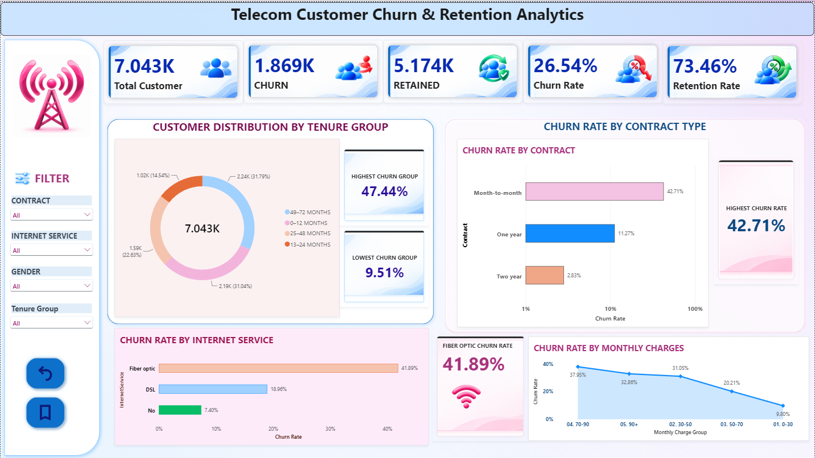
Power BI Dashboard
EXECUTIVE OVERVIEW CONTENTS
5 KPI cards
Customers, churn, retention
Churn by contract type
Churn by tenure group
Monthly charge segmentation
Interactive slicers
Contract, Internet Service, Gender, Tenure Group
Notes:
Describe the single-page Executive Overview dashboard: five KPI cards, contract and tenure churn charts, monthly-charge segmentation, and slicers for Contract, Internet Service, Gender and Tenure Group. Replace the placeholder with a real screenshot before presenting.

Slide 10
Conclusion & Next Steps
26.54%
42.71%
Takeaway
Customer segmentation and early retention initiatives can help the business prioritize retention efforts.
Overall churn rate
Month-to-month churn
47.44%
74.44 vs 61.27
First 12 months churn
Avg monthly charges: churned vs retained
Thank You
Notes:
Summarize the four key findings, restate that results are descriptive associations, then close and invite questions.

